Slide 1


Azərbaycan Dövlət Neft və Sənaye Universiteti
Linear Algebra

Slide 2
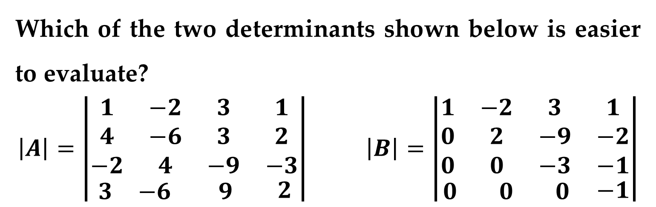
Which of the two determinants shown below is easier to evaluate?
$$\left|A\right|=\left|\begin{matrix}\begin{matrix}1 & −2 & 3 \\ 4 & −6 & 3 \\ −2 & 4 & −9\end{matrix} & \begin{matrix}1 \\ 2 \\ −3\end{matrix} \\ \begin{matrix}3 & −6 & 9\end{matrix} & 2\end{matrix}\right| \left|B\right|=\left|\begin{matrix}\begin{matrix}1 & −2 & 3 \\ 0 & 2 & −9 \\ 0 & 0 & −3\end{matrix} & \begin{matrix}1 \\ −2 \\ −1\end{matrix} \\ \begin{matrix}0 & 0 & 0\end{matrix} & −1\end{matrix}\right|$$
It is clear that the second determinant is much easier to evaluate: its determinant is simply the product of the entries on the main diagonal.
Evaluation of a Determinant Using Elementary Operations

Slide 3
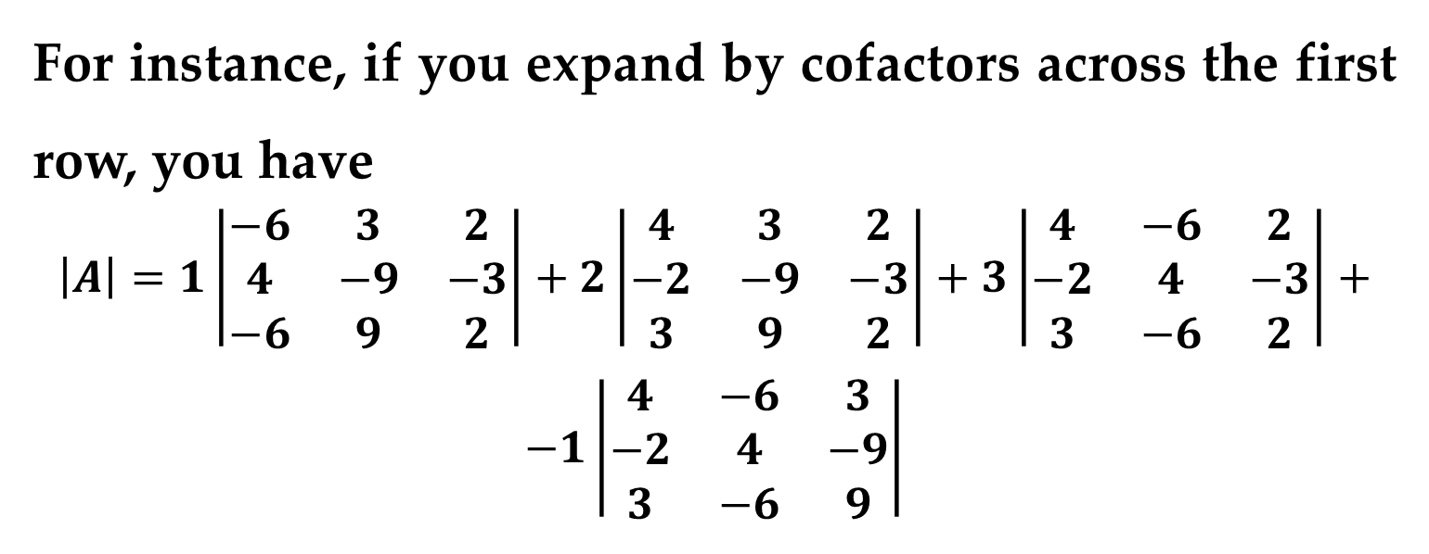
Using expansion by cofactors (the only technique discussed so far) to evaluate the first determinant is messy.
Example
For instance, if you expand by cofactors across the first row, you have
$$\left|A\right|=1\left|\begin{matrix}−6 & 3 & 2 \\ 4 & −9 & −3 \\ −6 & 9 & 2\end{matrix}\right|+2\left|\begin{matrix}4 & 3 & 2 \\ −2 & −9 & −3 \\ 3 & 9 & 2\end{matrix}\right|+3\left|\begin{matrix}4 & −6 & 2 \\ −2 & 4 & −3 \\ 3 & −6 & 2\end{matrix}\right|+$$
$$−1\left|\begin{matrix}4 & −6 & 3 \\ −2 & 4 & −9 \\ 3 & −6 & 9\end{matrix}\right|$$
Evaluation of a Determinant

Slide 4
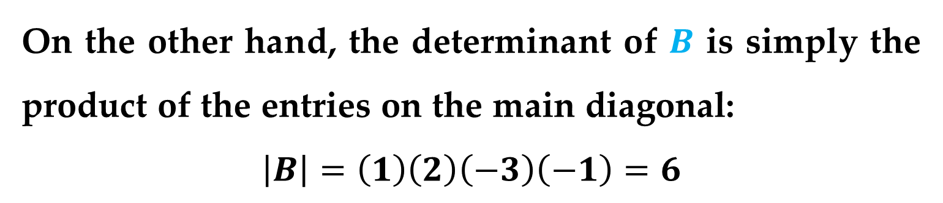
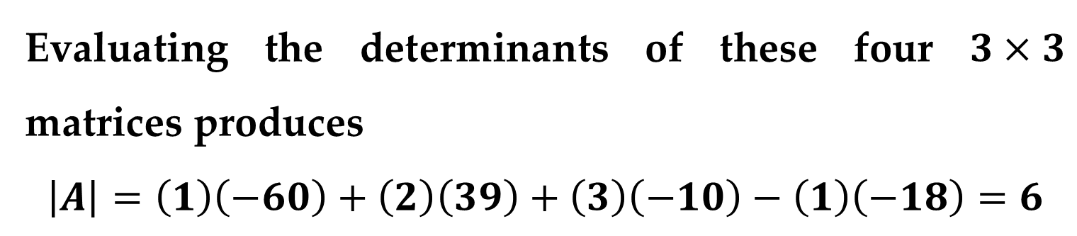
Example
Evaluating the determinants of these four $3×3$ matrices produces
$$\left|A\right|=\left(1\right)\left(−60\right)+\left(2\right)\left(39\right)+\left(3\right)\left(−10\right)−\left(1\right)\left(−18\right)=6$$
On the other hand, the determinant of $B$ is simply the product of the entries on the main diagonal:
$$\left|B\right|=\left(1\right)\left(2\right)\left(−3\right)\left(−1\right)=6$$
It is not coincidental that these two determinants have the same value.
Evaluation of a Determinant

Slide 5
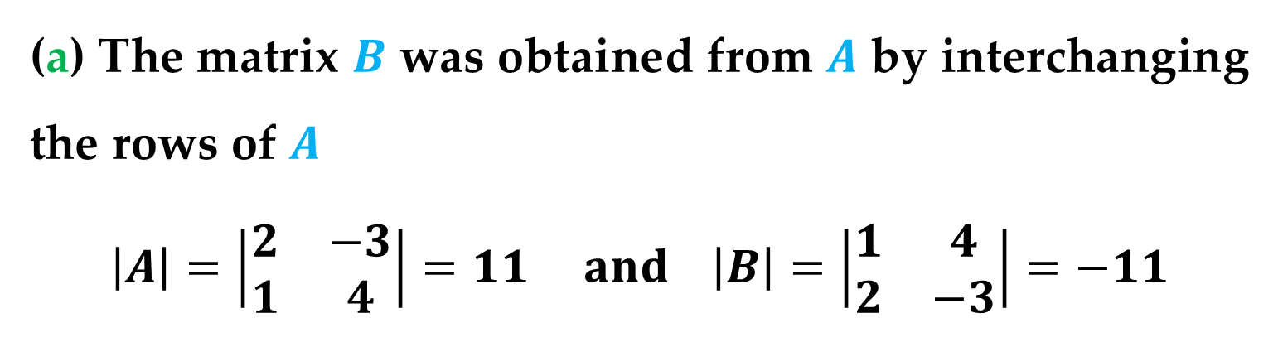
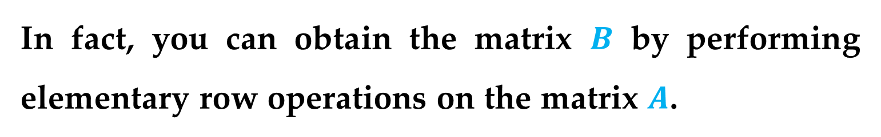
In fact, you can obtain the matrix $B$ by performing elementary row operations on the matrix $A$.
Example 1. The Effects of Elementary Row Operations on a Determinant
(a) The matrix $B$ was obtained from $A$ by interchanging the rows of $A$
$$\left|A\right|=\left|\begin{matrix}2 & −3 \\ 1 & 4\end{matrix}\right|=11 and \left|B\right|=\left|\begin{matrix}1 & 4 \\ 2 & −3\end{matrix}\right|=−11$$
Evaluation of a Determinant

Slide 6
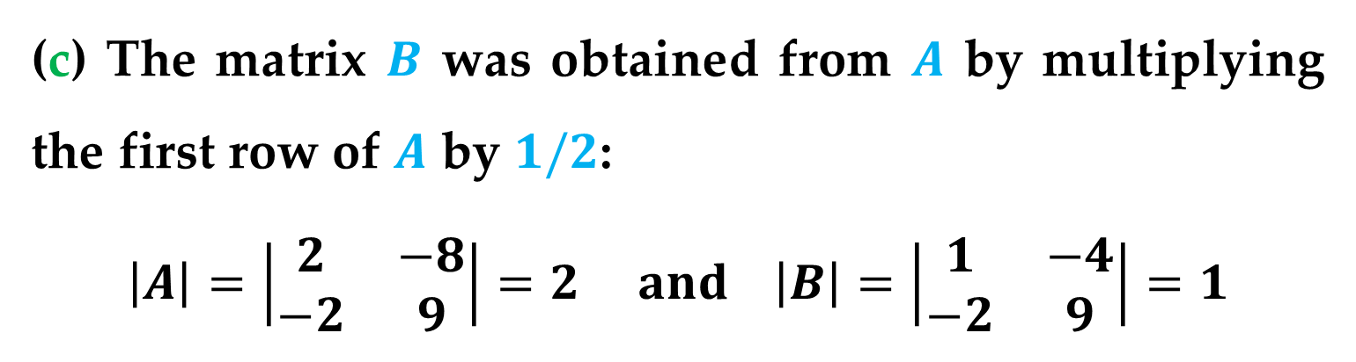
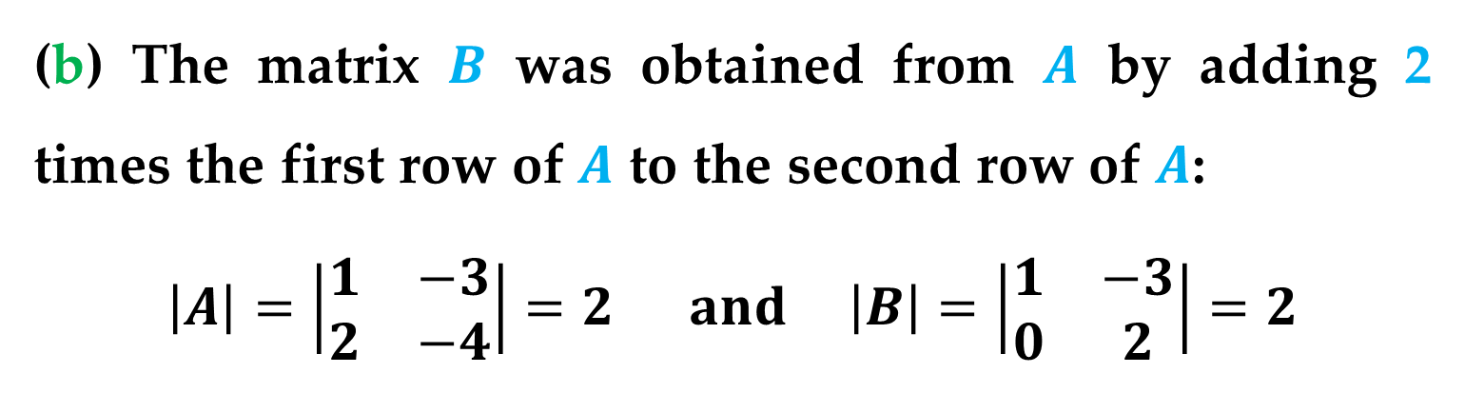
Example 1. The Effects of Elementary Row Operations on a Determinant
(b) The matrix $B$ was obtained from $A$ by adding 2 times the first row of $A$ to the second row of $A$:
$$\left|A\right|=\left|\begin{matrix}1 & −3 \\ 2 & −4\end{matrix}\right|=2 and \left|B\right|=\left|\begin{matrix}1 & −3 \\ 0 & 2\end{matrix}\right|=2$$
(c) The matrix $B$ was obtained from $A$ by multiplying the first row of $A$ by $1/2$:
$$\left|A\right|=\left|\begin{matrix}2 & −8 \\ −2 & 9\end{matrix}\right|=2 and \left|B\right|=\left|\begin{matrix}1 & −4 \\ −2 & 9\end{matrix}\right|=1$$
Evaluation of a Determinant

Slide 7
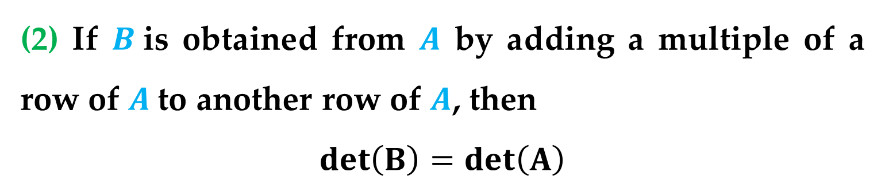
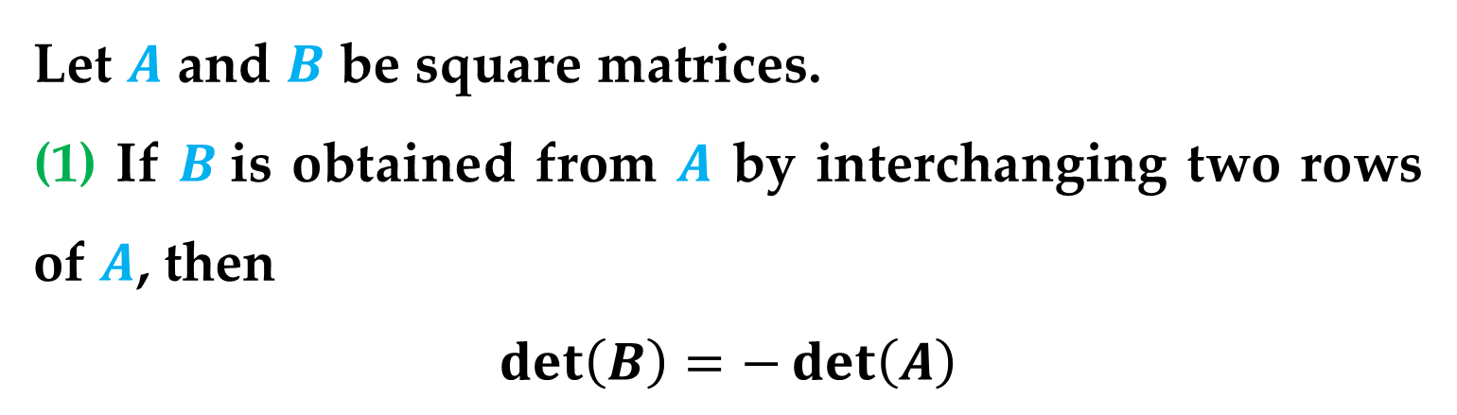
Theorem 1. Elementary Row Operations and Determinants
Let $A$ and $B$ be square matrices.
(1) If $B$is obtained from $A$ by interchanging two rows of $A$, then
$$\det\left(B\right)=−\det\left(A\right)$$
(2) If $B$is obtained from $A$ by adding a multiple of a row of $A$to another row of $A$, then
$$\det\left(B\right)=\det\left(A\right)$$
Evaluation of a Determinant

Slide 8
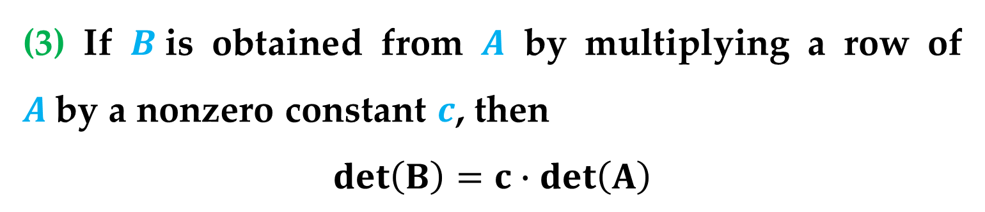
Theorem 1. Elementary Row Operations and Determinants
(3) If $B$is obtained from $A$ by multiplying a row of $A$by a nonzero constant $c$, then
$$\det\left(B\right)=c∙\det\left(A\right)$$
Evaluation of a Determinant

Slide 9
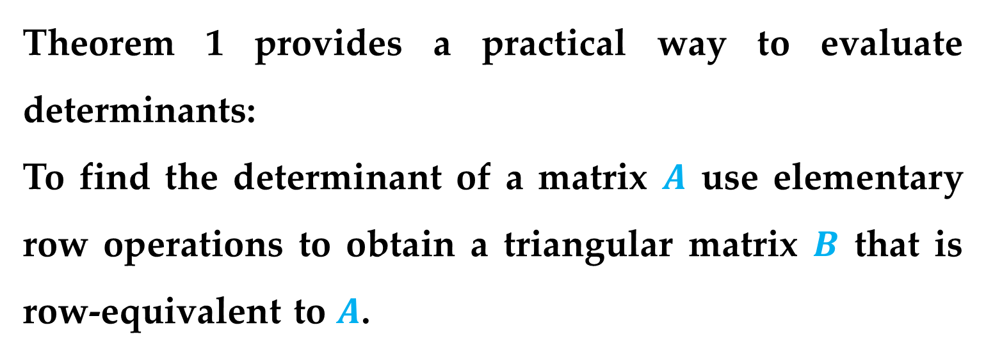
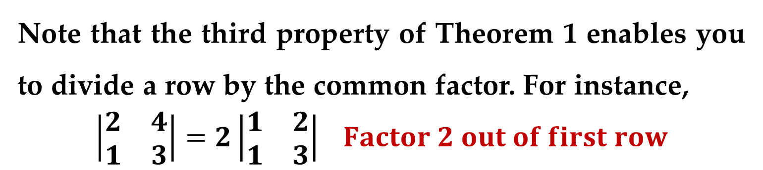
Remark
Note that the third property of Theorem 1 enables you to divide a row by the common factor. For instance,
$$\left|\begin{matrix}2 & 4 \\ 1 & 3\end{matrix}\right|=2\left|\begin{matrix}1 & 2 \\ 1 & 3\end{matrix}\right| Factor 2 out of first row$$
Theorem 1 provides a practical way to evaluate determinants:
To find the determinant of a matrix $A$ use elementary row operations to obtain a triangular matrix $B$ that is row-equivalent to $A$.
Evaluation of a Determinant

Slide 10

For each step in the elimination process, use Theorem 1 to determine the effect of the elementary row operation on the determinant.
Finally, find the determinant of $B$ by multiplying the entries on its main diagonal.
Evaluation of a Determinant

Slide 11

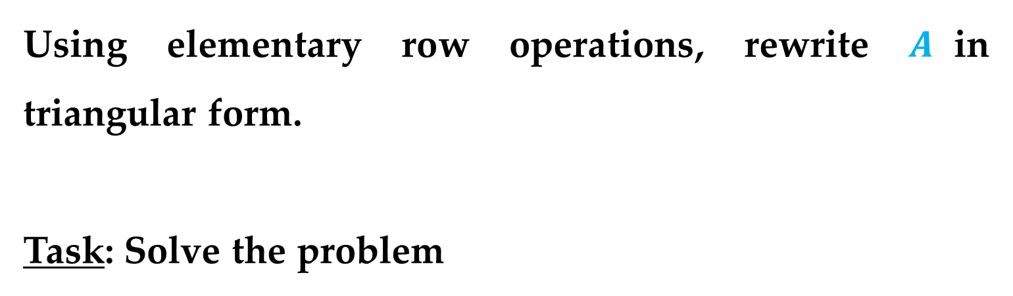
Example 2. Evaluating a Determinant Using Elementary Row Operations
Find the determinant of
$$A=\left[\begin{matrix}2 & −3 & 10 \\ 1 & 2 & −2 \\ 0 & 1 & −3\end{matrix}\right]$$
Solution
Using elementary row operations, rewrite $A$in triangular form.
Task: Solve the problem
Evaluation of a Determinant

Slide 12
Although Theorem 1 is stated in terms of elementary row operations, the theorem remains valid if the word “column” replaces the word “row.”
Operations performed on the columns (rather than the rows) of a matrix are called elementary column operations.
Two matrices are called column-equivalent if one can be obtained from the other by elementary column operations.
Elementary Column Operations

Slide 13
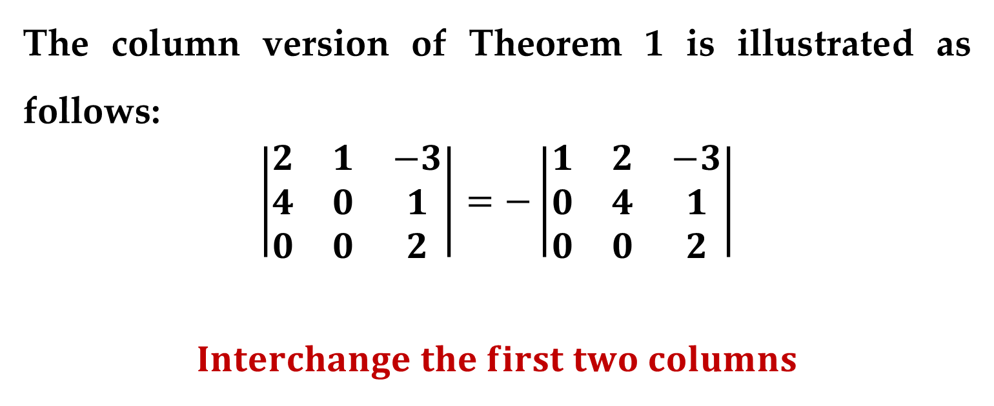
Example
The column version of Theorem 1 is illustrated as follows:
$$\left|\begin{matrix}2 & 1 & −3 \\ 4 & 0 & 1 \\ 0 & 0 & 2\end{matrix}\right|=−\left|\begin{matrix}1 & 2 & −3 \\ 0 & 4 & 1 \\ 0 & 0 & 2\end{matrix}\right|$$
$$Interchange the first two columns$$
Elementary Column Operations

Slide 14
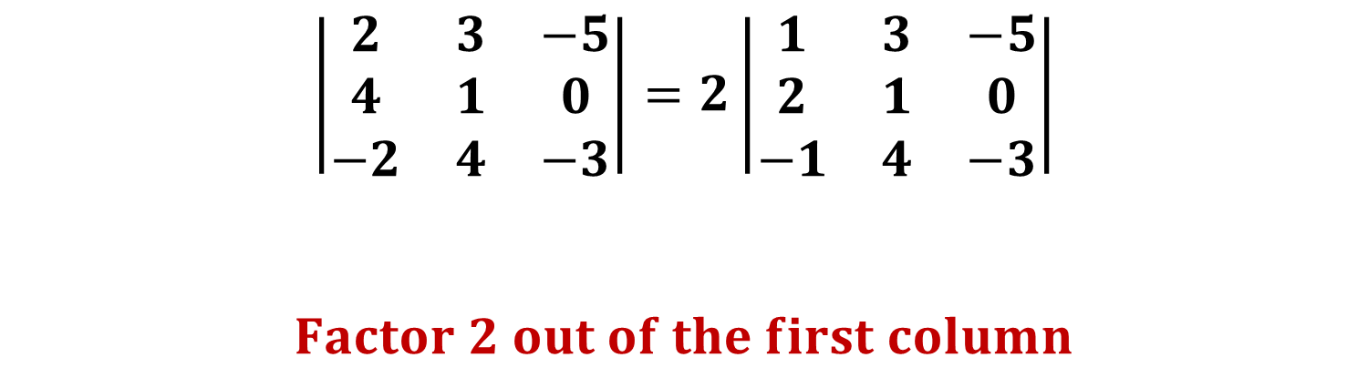
Example (continued)
$$\left|\begin{matrix}2 & 3 & −5 \\ 4 & 1 & 0 \\ −2 & 4 & −3\end{matrix}\right|=2\left|\begin{matrix}1 & 3 & −5 \\ 2 & 1 & 0 \\ −1 & 4 & −3\end{matrix}\right|$$
$$Factor 2 out of the first column$$
Elementary Column Operations

Slide 15
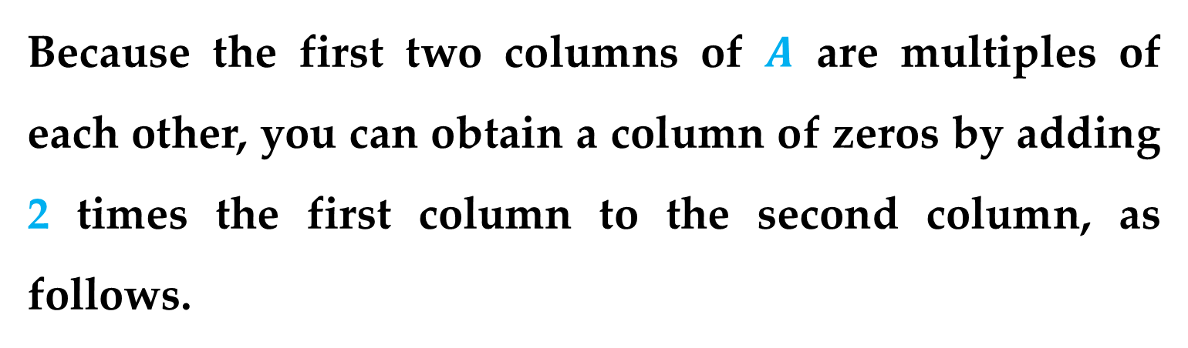

Example 3. Evaluating a Determinant Using Elementary Column Operations
Find the determinant of
$$A=\left[\begin{matrix}−1 & 2 & 2 \\ 3 & −6 & 4 \\ 5 & −10 & −3\end{matrix}\right]$$
Solution
Because the first two columns of $A$ are multiples of each other, you can obtain a column of zeros by adding 2 times the first column to the second column, as follows.
Elementary Column Operations

Slide 16
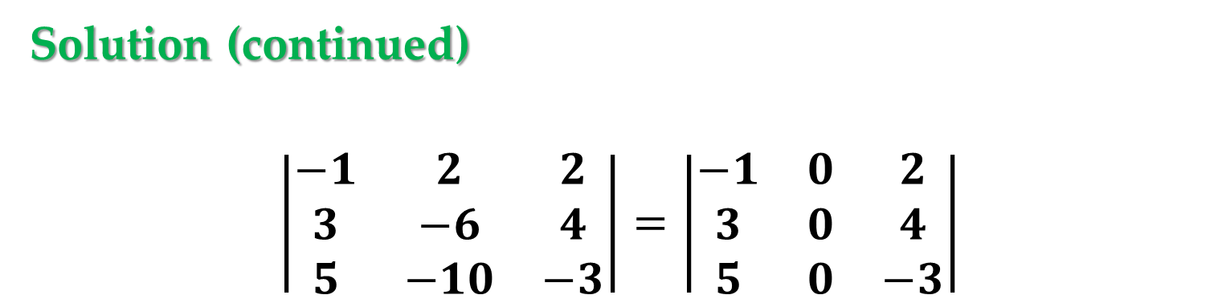
Solution (continued)
$$\left|\begin{matrix}−1 & 2 & 2 \\ 3 & −6 & 4 \\ 5 & −10 & −3\end{matrix}\right|=\left|\begin{matrix}−1 & 0 & 2 \\ 3 & 0 & 4 \\ 5 & 0 & −3\end{matrix}\right|$$
At this point you do not need to continue to rewrite the matrix in triangular form:
Because there is an entire column of zeros, simply conclude that the determinant is zero.
Elementary Column Operations

Slide 17
Remark
Example 3 shows that if one column of a matrix is a scalar multiple of another column, you can immediately conclude that the determinant of the matrix is zero.
This is one of three conditions, listed next, that yield a determinant of zero.
Elementary Column Operations

Slide 18
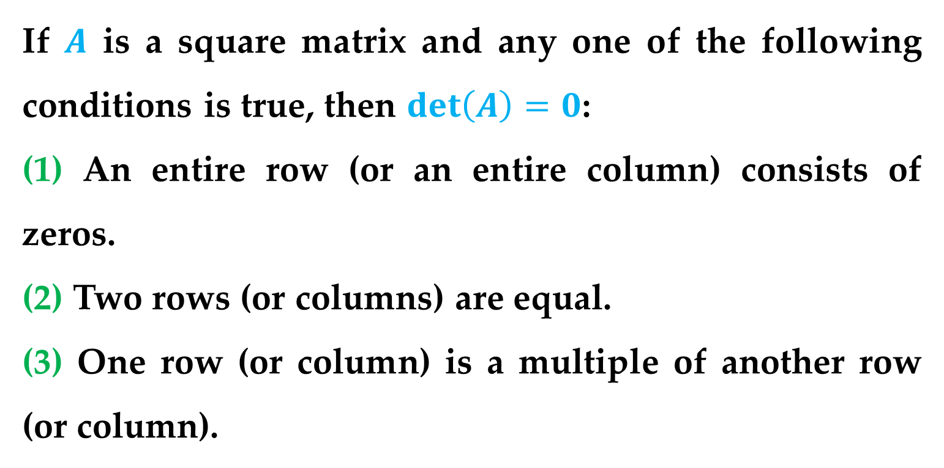
Theorem 2. Conditions That Yield a Zero Determinant
If $A$ is a square matrix and any one of the following conditions is true, then $\det\left(A\right)=0$:
(1) An entire row (or an entire column) consists of zeros.
(2) Two rows (or columns) are equal.
(3) One row (or column) is a multiple of another row (or column).
Elementary Column Operations

Slide 19
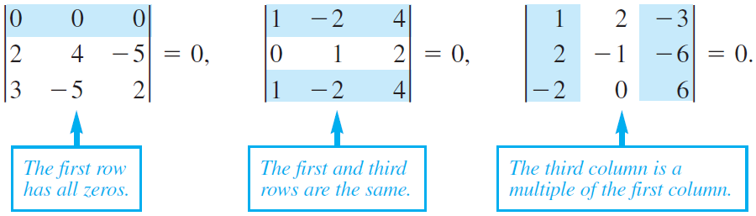
Example
Warning
Do not conclude, however, that Theorem 2 gives the only conditions that produce a determinant of zero.
Elementary Column Operations

Slide 20
Note
This theorem is often used indirectly – that is, you can begin with a matrix that does not satisfy any of the conditions of Theorem 2 and, through elementary row or column operations, obtain a matrix that does satisfy one of the conditions.
Only then you can conclude that the original matrix has a determinant of zero.
Elementary Column Operations

Slide 21
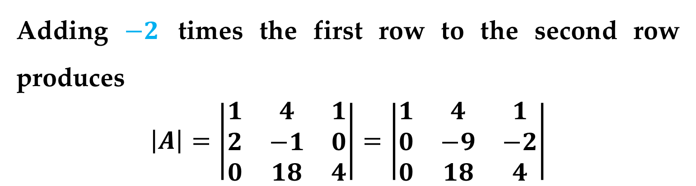

Example 4. A Matrix with a Zero Determinant
Find the determinant of
$$A=\left[\begin{matrix}1 & 4 & 1 \\ 2 & −1 & 0 \\ 0 & 18 & 4\end{matrix}\right]$$
Solution
Adding $−2$ times the first row to the second row produces
$$\left|A\right|=\left|\begin{matrix}1 & 4 & 1 \\ 2 & −1 & 0 \\ 0 & 18 & 4\end{matrix}\right|=\left|\begin{matrix}1 & 4 & 1 \\ 0 & −9 & −2 \\ 0 & 18 & 4\end{matrix}\right|$$
Because the second and third rows are multiples of each other, we conclude that the determinant is zero.

Slide 22
Conclusion
You have now surveyed two general methods for evaluating determinants.
Of these, the method of using elementary row operations to reduce the matrix to triangular form is usually faster than cofactor expansion along a row or column.
If the matrix is large, then the number of arithmetic operations needed for cofactor expansion can become extremely large.
Elementary Column Operations

Slide 23
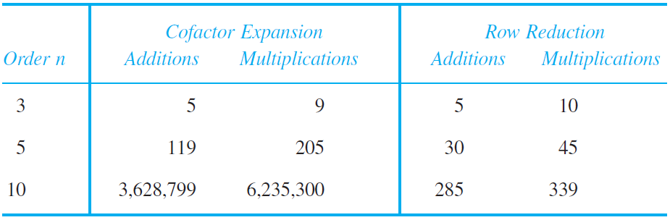
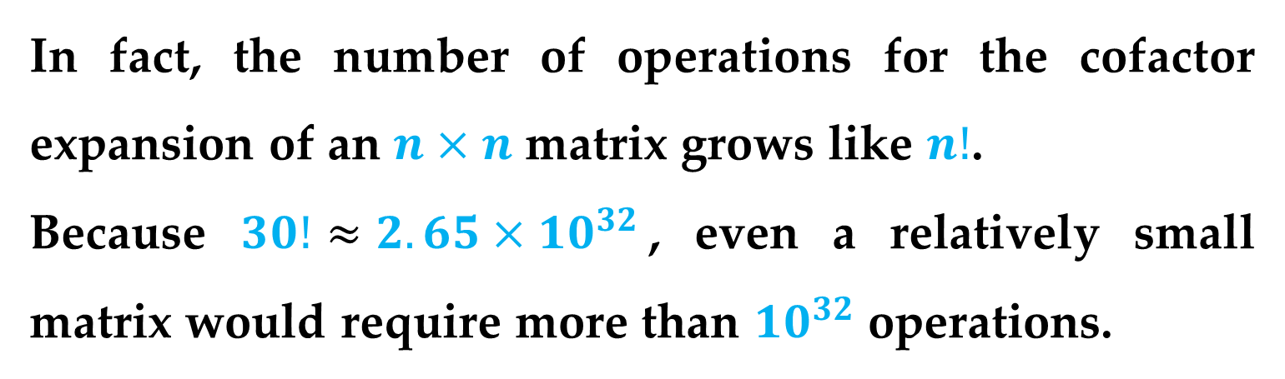
Table 1
In fact, the number of operations for the cofactor expansion of an $n×n$ matrix grows like $n!$.
Because $30!≈2.65×{10}^{32}$, even a relatively small matrix would require more than ${10}^{32}$ operations.
Elementary Column Operations

Slide 24
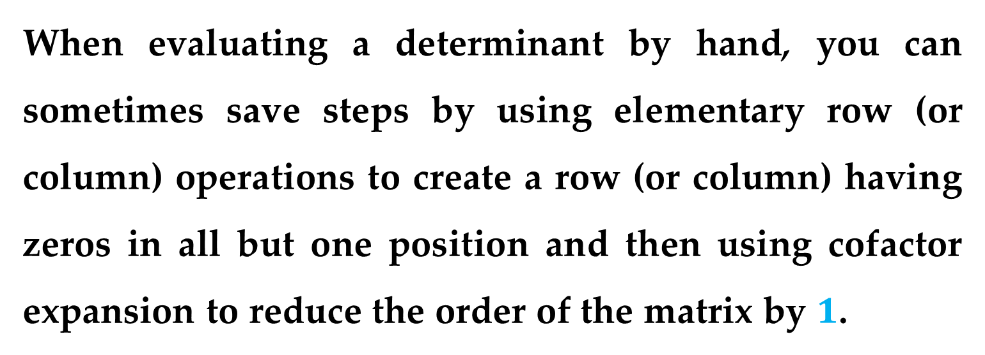
Remark
When evaluating a determinant by hand, you can sometimes save steps by using elementary row (or column) operations to create a row (or column) having zeros in all but one position and then using cofactor expansion to reduce the order of the matrix by $1$.
Elementary Column Operations

Slide 25
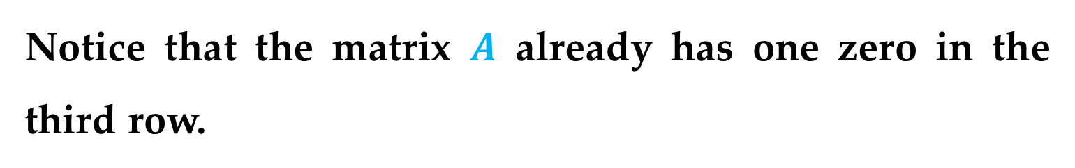

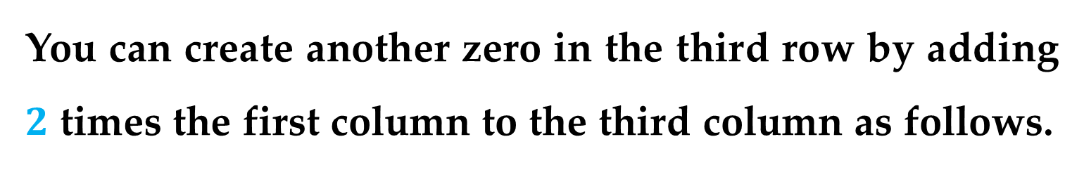
Example 5. Evaluating a Determinant
Find the determinant of
$$A=\left[\begin{matrix}−3 & 5 & 2 \\ 2 & −4 & −1 \\ −3 & 0 & 6\end{matrix}\right]$$
Solution
Notice that the matrix $A$ already has one zero in the third row.
You can create another zero in the third row by adding $2$ times the first column to the third column as follows.
Elementary Column Operations

Slide 26
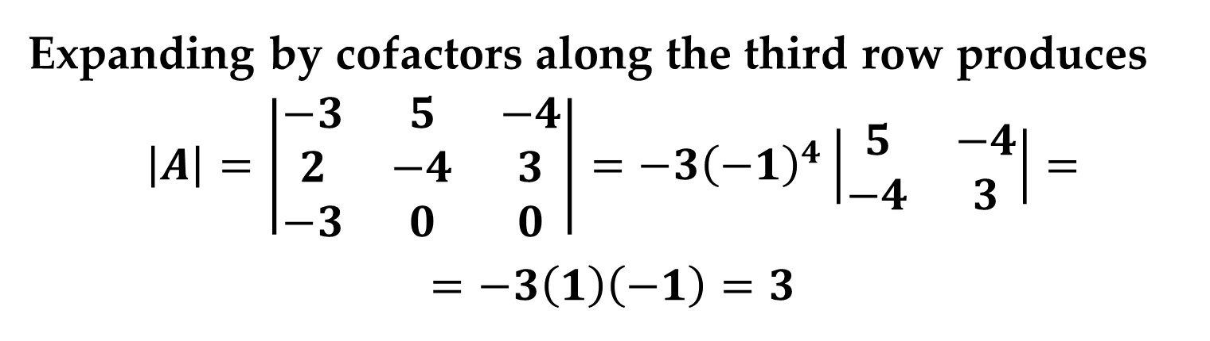

Solution (continued)
$$\left|A\right|=\left|\begin{matrix}−3 & 5 & 2 \\ 2 & −4 & −1 \\ −3 & 0 & 6\end{matrix}\right|=\left|\begin{matrix}−3 & 5 & −4 \\ 2 & −4 & 3 \\ −3 & 0 & 0\end{matrix}\right|$$
Expanding by cofactors along the third row produces
$$\left|A\right|=\left|\begin{matrix}−3 & 5 & −4 \\ 2 & −4 & 3 \\ −3 & 0 & 0\end{matrix}\right|=−3{\left(−1\right)}^{4}\left|\begin{matrix}5 & −4 \\ −4 & 3\end{matrix}\right|=$$
$$=−3\left(1\right)\left(−1\right)=3$$
Elementary Column Operations

Slide 27
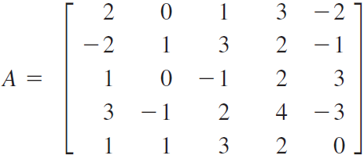
Example 6. Evaluating a Determinant
Evaluate the determinant of
Solution
Because the second column of this matrix already has two zeros, choose it for cofactor expansion.
Elementary Column Operations

Slide 28
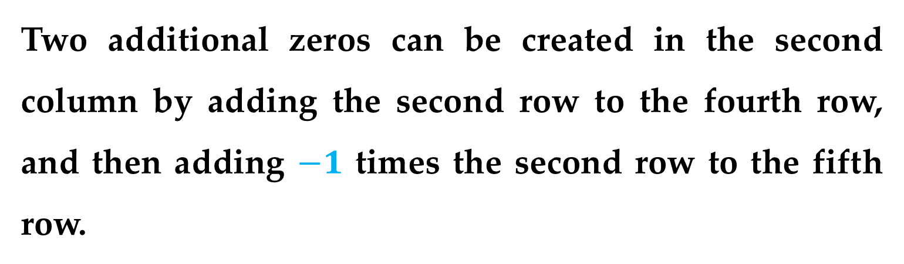
Solution (continued)
Two additional zeros can be created in the second column by adding the second row to the fourth row, and then adding $−1$ times the second row to the fifth row.
Elementary Column Operations

Slide 29
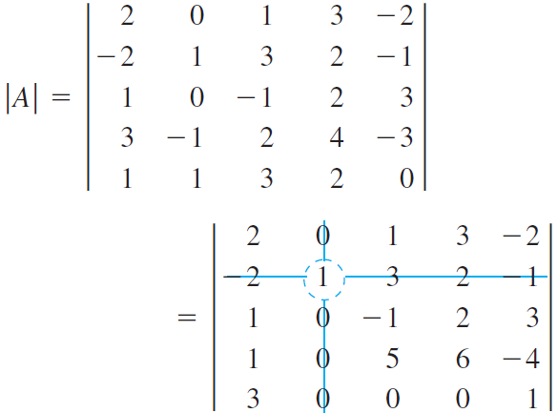
Solution (continued)
Elementary Column Operations

Slide 30
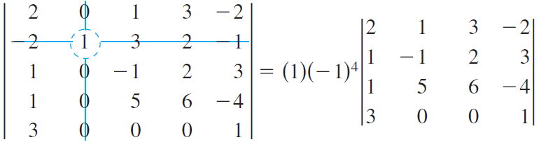
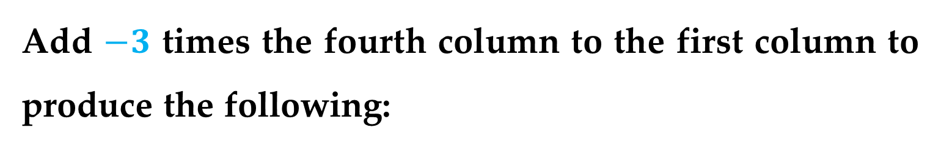
Solution (continued)
Because we already have two zeros in the fourth row, it is chosen for the next cofactor expansion.
Add $−3$ times the fourth column to the first column to produce the following:
Elementary Column Operations

Slide 31
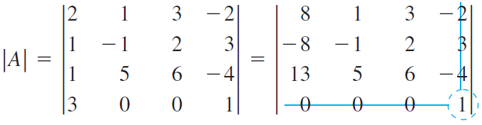
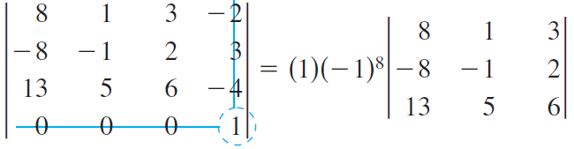
Solution (continued)
Add the second row to the first row and then expand by cofactors along the first row.

Slide 32
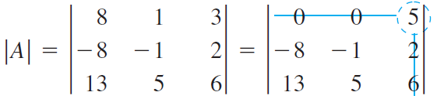
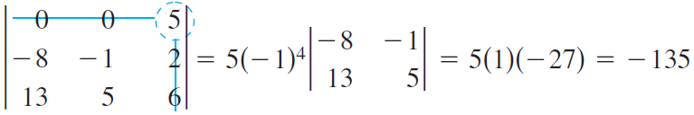
Solution (continued)
Add the second row to the first row and then expand by cofactors along the first row.
Elementary Column Operations

Slide 33
Thank You for Attention

